Slide 1
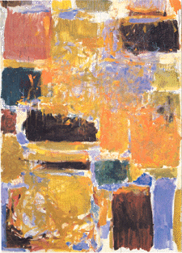
Digital Integrated Circuits A Design Perspective
Jan M. Rabaey
Anantha Chandrakasan
Borivoje Nikolic
Design Methodologies
December 3, 2002

Slide 2
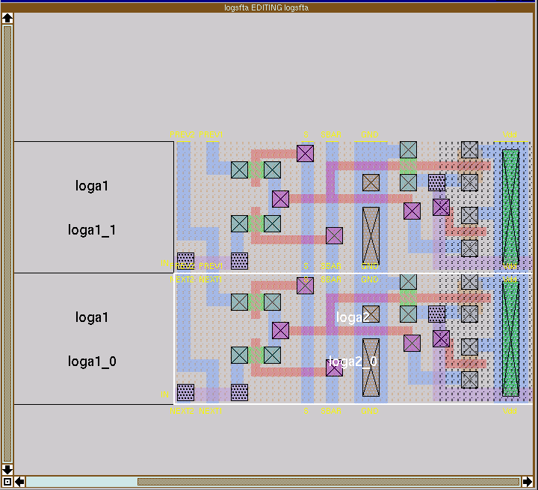
Custom Design – Layout Editor
Magic Layout Editor
(UC Berkeley)

Slide 3
Symbolic Layout
Dimensionless layout entities
Only topology is important
Final layout generated by “compaction” program
Stick diagram of inverter

